Slide 1
2018-2019 Season

Slide 2
Studio Room Show
Doubt
A Parable
By John Patrick Shanley
In 1962, a nun must struggle with what she has been taught to be true, what she knows to be true and what she suspects to be true. She accuses a young priest of inappropriate contact with one of their students. The central question of the play is where you find certainty in uncertain times, especially when all you have known is thrown out.

Slide 3
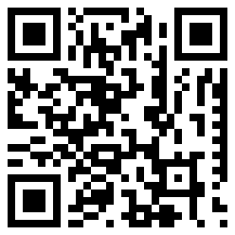
Our website:
www.bcsc.k12.in.us/northdrama

Slide 4
Spring Play
The Curious Incident of the Dog in the Night-Time
A play by Simon Stephens
Based on the novel by Mark Haddon
Christopher is discovered standing over a dead dog, stabbed with a garden fork. When he is accused of the crime he knows that would never murder his good friend, so he sets out to solve the mystery and find the real killer. Christopher’s journey becomes one into his own history and family. This story is beautifully told from the perspective of Christopher, an autistic teen.

Slide 5
Phone number:
812-376-4236

Slide 6
Musical
Music and Lyrics by
Richard M. Sherman and Robert B. Sherman
Book by
Julian Fellowes
New Songs and Music and Lyrics by
George Stiles and Anthony Drewe
The Banks family is broken, and only one person can save the day, the mysterious, magical super nanny, Mary Poppins. More than just an adaptation of the beloved Disney movie, the stage show uses tales told from the original books, the beloved music from the music and some of those favorite film scenes to create a one of a kind stage event!

Slide 7
Receive North Drama Text Updates
Text: @drnorth
to
219-951-4571

Slide 8
Trip to Humana Festival of New Plays
March 8-10, 2019
Louisville, KY
Open to all students involved in theatre.
We try to see 4-6 shows.
Info for trip out in January.

Slide 9
Showcase 2017
Seniors completing a senior project in theatre or students interested in trying their hand at directing mount an evening of plays of their choosing.

Slide 10
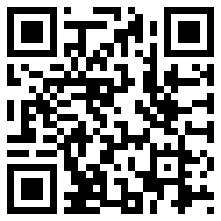
Follow Us
www.facebook.com/drama.at.north
@northdrama

Slide 11
A world-wide theatre honorary for high school students.
Members are invited to join after accumulating at least 10 points. Points are awarded for each theatre production a student is involved with during high school.

Slide 12
Indiana Thespian State Festival
January 18-20
Indianapolis, IN
Open to all interested students
8-10 high schools do cuttings of longer shows, or one acts.
Workshops and smaller competitions.

Slide 13
How to get involved with Crew
At start of each big production we have a crew call-out, where schedules are passed out.
If you want to be on crew you come to any scheduled time that you can.
You can come once a week or everyday.
At any crew session you may be asked build sets, paint backgrounds, sew costumes, gather props, hang lights or whatever. Be prepared.
Running Crew (those that work the actual show) is selected from the regular crew.

Slide 14
Auditions (non-musical)
Open to all North students and staff.
Will usually involve readings from the script.
Scripts are almost always available to be read ahead of time in resource periods.
Be prepared to do anything the director wants and have fun.

Slide 15
Auditions (musical)
Open to all North students and staff.
Prepare a short song (16-32 bars) to be sung with accompaniment. Sometimes we provide songs to sing.
Will involve readings from the script.
Most musicals will involve some sort of dance audition. Be prepared to move.
Be prepared to do anything the director wants and have fun.

